Slide 1
雅思听力
多选题

Slide 2
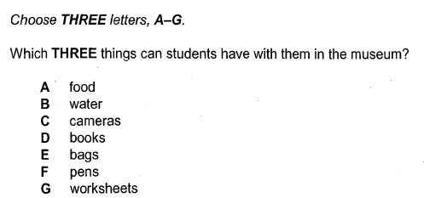
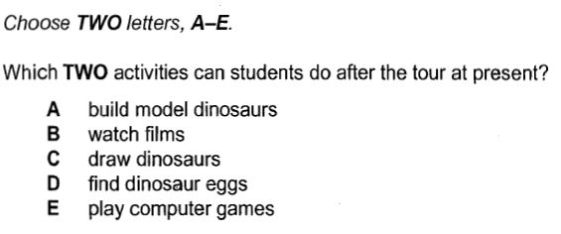
C8T1S2 P12
有5选2 或 7选3，多为5选2
没有连带责任
选项不按顺序出现

Slide 3
多选题解题步骤
听前：
题干
（划关键词—定位词，限定词）
选项：
短：速记中文含义
长：划关键词(划差异）
注意：如有同类项，必然产生一个正确答案

Slide 4
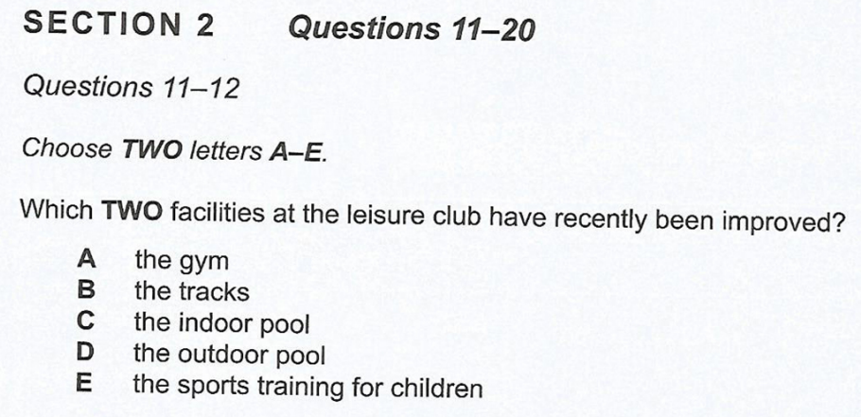
10-1-2 p12
同类项 - 必然产生一个正确答案

Slide 5
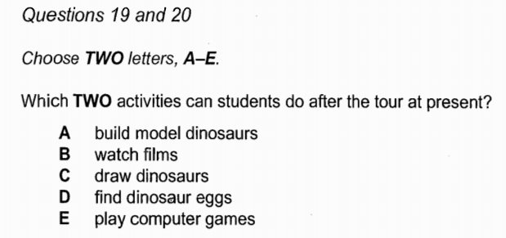
8-1-2 p13
Dinosaur Museum
不属于同类项

Slide 6
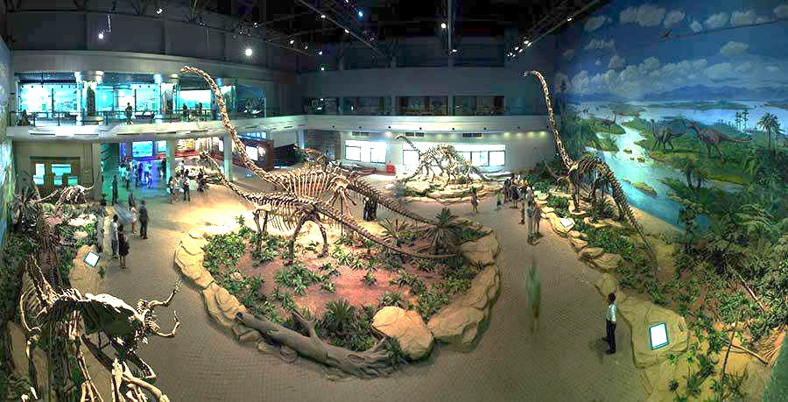
Dinosaur Museum
C8T1S2 P12

Slide 7

听前：
题干
（划关键词—定位词，限定词）
选项：
短：速记中文含义
长：划关键词
注意：如有同类项，必然产生一个正确答案
C8T1S2 P12

Slide 8
Answers
16-18
C
F
G
19-20
B
E
C8T1S2 P12

Slide 9
C8T1S2 P12
should not bring anything to eat or drinks
check in
寄存
backpack
handouts with questions and quizzes
used to have
documentaries
纪录片

Slide 10
多选题解题步骤
听中：
定位
路标词（转折，因果，并列)
排除法
否定陷阱
答非所问
偷梁换柱
Tip:使用and, or, as well as, also等连接选项表示选项同时选择或同时排除

Slide 11
单/多选题-时间限定考点
过去 | used to do | last year | past | previously
 | did(动词过去式) | originally | initially | was doing
 | former | ago | before
现在 | at present | at the moment | current | currently
 | now | nowadays | be doing
将来 | future | be about to do | be going to do | long-term
 | plan to do | intend to do | consider | thinking about
 | look into the possibility of doing | next year | next semester | in due course

Slide 12
时间限定考点多选题 practice
11-2-2 p35

Slide 13
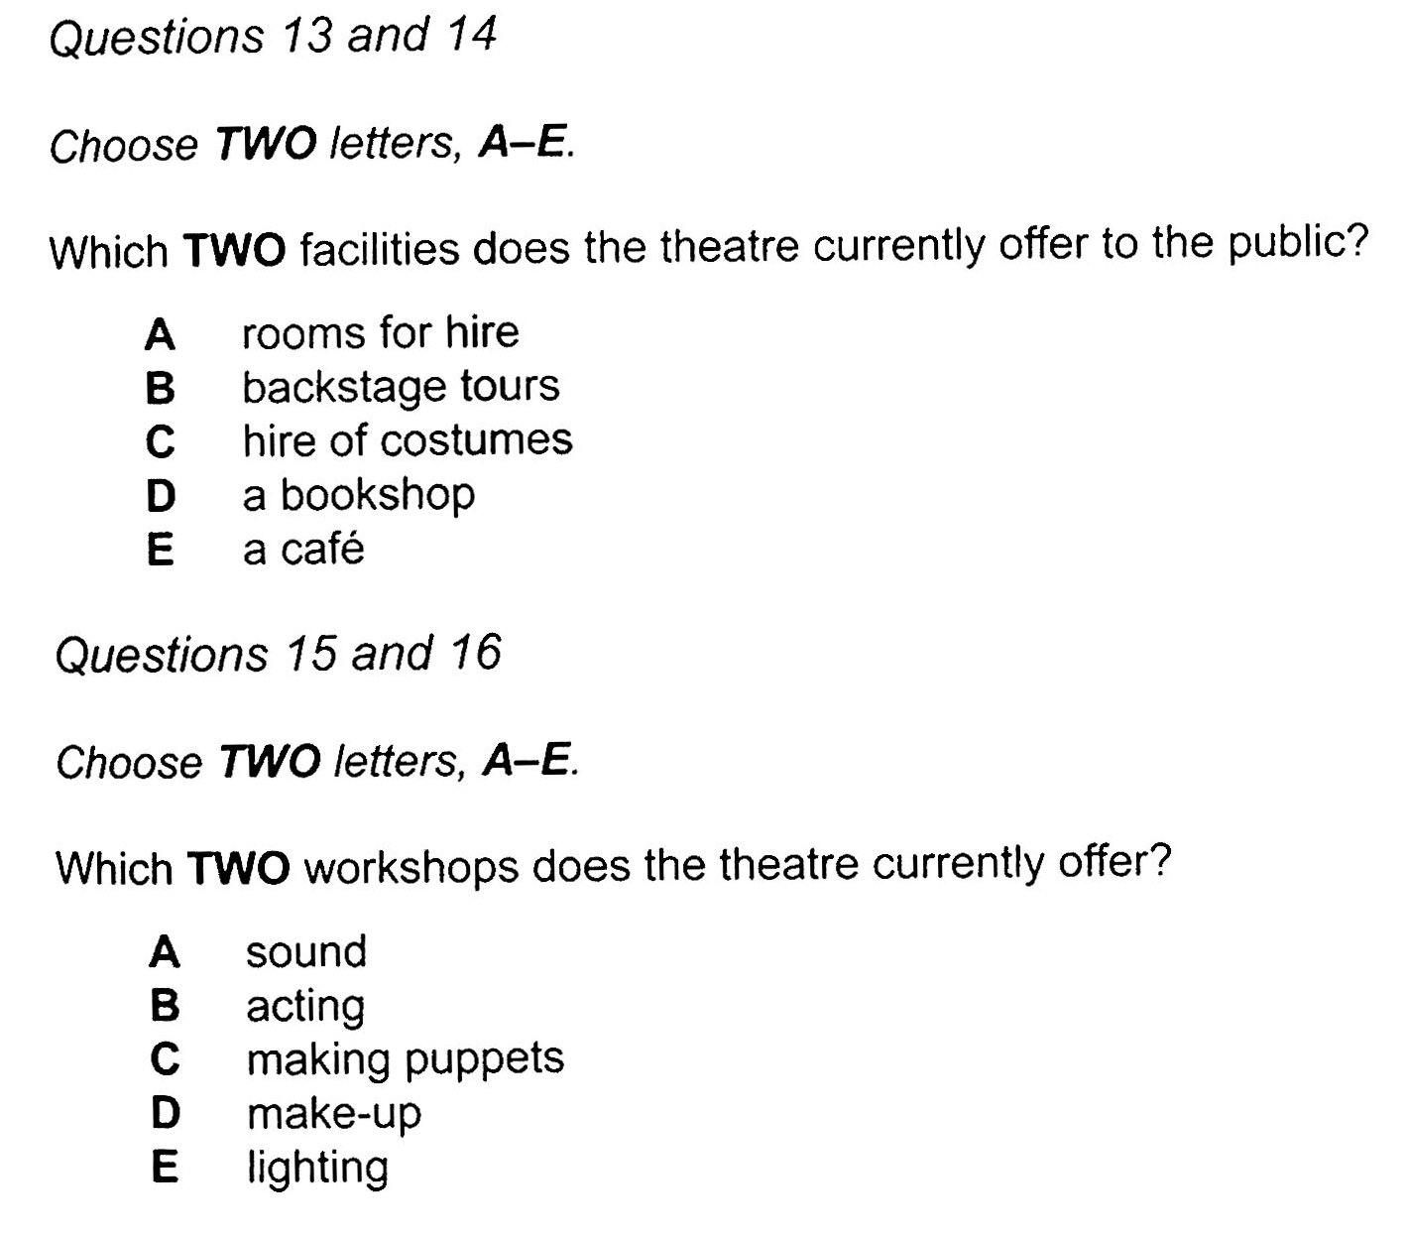
11-2-2 p35
1’25’’

Slide 14
13-14
B
D
15-16
C
E
1’25’’

Slide 15
11-2-2 p35
next month
considering
look into the possibility of opening a cafe
going to next month
intend to, but we’re waiting
considering for the future

Slide 16
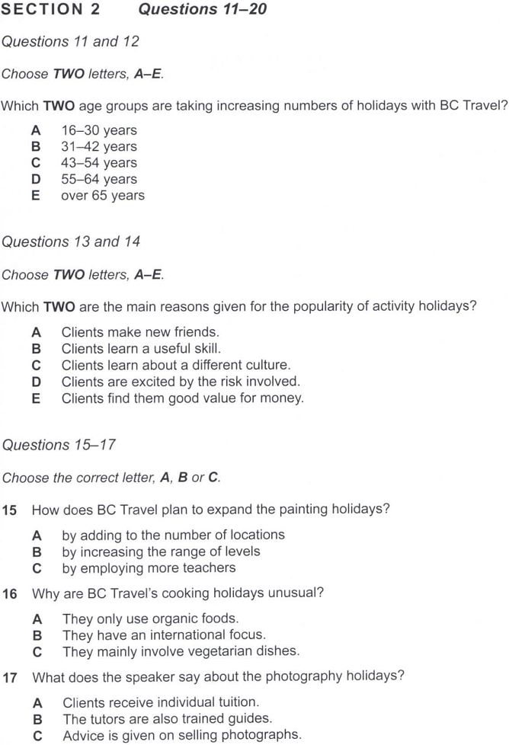
12-7-2 p54
0’50’’

Slide 17
12-7-2 p54
Answers
D E
0’50’’

Slide 18
12-7-2 p54
but the biggest drop
no sign of rising
but we haven’t seen the increase
noticeable growth
increasing steadily year on year

Slide 19
10-1-2 p12

Slide 20
10-1-2 p12

Slide 21
10-1-2 p12
Answers
A
C

Slide 22
10-1-2 p12
latest exercise equipment, including ten new running machines and weight-training machines
unfortunately, there isn’t space for an outdoor pool here
continue to benefit
expand to 8 lanes，much wider

Slide 23
11-2-2 p35
Questions 11 and 12
Choose TWO letters, A-E.
Which TWO changes have been made so far during the refurbishment of the theatre?
A Some rooms now have a different use.
B A different type of seating has been installed.
C An elevator has been installed.
D The outside of the building has been repaired.
E Extra seats have been added.

Slide 24
Answers
11-12
A
B

Slide 25
11-2-2 p35
Questions 11 and 12
Choose TWO letters, A-E.
Which TWO changes have been made so far during the refurbishment of the theatre?
A Some rooms now have a different use.
B A different type of seating has been installed.
C An elevator has been installed.
D The outside of the building has been repaired.
E Extra seats have been added.

Slide 26
12-7-2 p54
2’02

Slide 27
12-7-2 p54
Answers
2’02
A
C

Slide 28
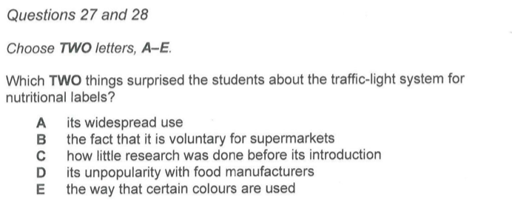
多选题13-4-3
剑13-4-3（P80）

Slide 29
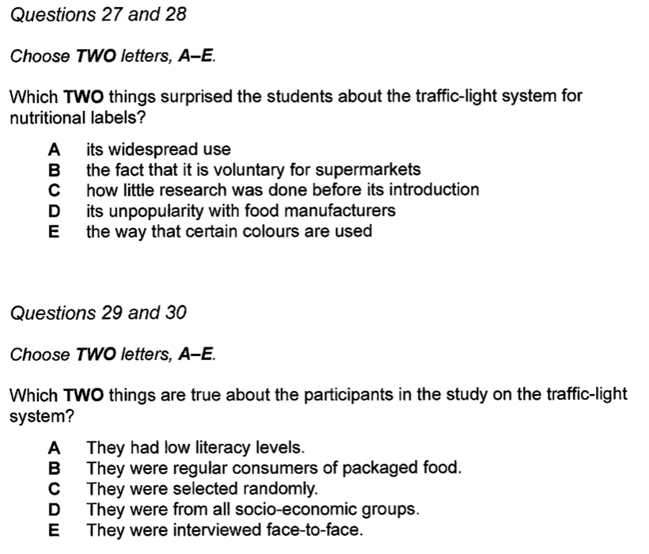
多选题13-4-3
剑13-4-3（P80）

Slide 30
B
C
But it’s not been adopted universally. And not on all products. –A 
Pressure from the food manufacturers. Hardly surprising that some of them are opposed to flagging up how unhealthy their products are. D
I’d have thought it would have been compulsory. It seems ridiculous it isn’t. B 
I know. And what I couldn‘t get over is the fact that it was brought in without enough consultation. - C 
That is a bit weird. (评论完将会切换话题)
剑13-4-3（P80）

Slide 31
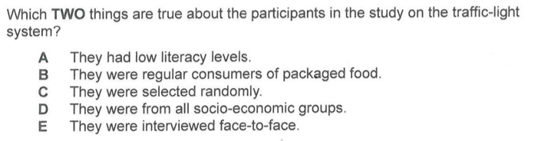
剑13-4-3（P80）
D
E
But I don’t think they targeted the right people. They should have focused on people with low literacy levels. A  should have done 本来应该做，但没有
But it's good to get feedback from all socio-economic groups. D 
But if they hadn’t interviewed participants face-to-face, they could have used a much bigger sample size. E 
If they hadn’t 要不是 … (实际已做), could have done 本来可以，
I think they volunteered. C
The thing that wasn’t stated was how often they bought packaged food - all we know is how frequently they used the supermarket – B

Slide 32
could/ should/ would have done …
本该做却没做
对过去事情的假设
否定
can’t have done
不可能做过
对过去事情的怀疑/否定推测
辨音难点
would’ve /wʊ dəv/
should’ve /ʃʊ dəv/
could’ve /kʊ dəv/
must have done
一定做过
对过去事情的肯定推测
can have done
可能做过
对过去事情的怀疑/否定推测
肯定
may/might have done
可能做过
对已经发生过的事情的推测
if XXX hadn't done
要不是xxx这样做了，表示做过

Slide 33
多选题解题技巧
审题+正选反除
转折排除
并列排除
排除干扰
选项或题干任意不一致
否定选项
划定位 (题干&选项)
听意群
比选项
比题干
范围不符
题干无关
选择答案
选项和题干都一致
同意替换

